Slide 1
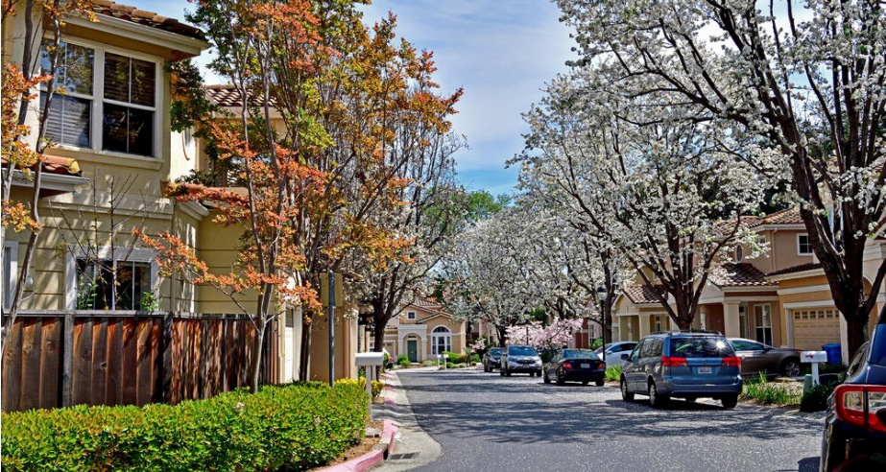



CITY OF CUPERTINO BELOW MARKET RATE PROGRAM
Below Market Rate (BMR)
Informational Workshop
Presented by Rise Housing Solutions
September 16, 2024

Slide 2


REMINDER:
Zoom is being recorded and the recording will be made available following the meeting.
ONLINE: https://www.risehousing.com/applicants-cupertino-bmr-homeownership
BMR WORKSHOP | 2025

Slide 3


Tonight’s Agenda
  Rise Housing Solutions Overview
  Overview of the BMR Rental Program
  Overview of the BMR Ownership Program
  Priority Points and Lottery Process
  How to join the 2025 Waitlist
  Questions
BMR WORKSHOP | 2025
Notes:
Questions – Type into the chat as they pop up.

Slide 4
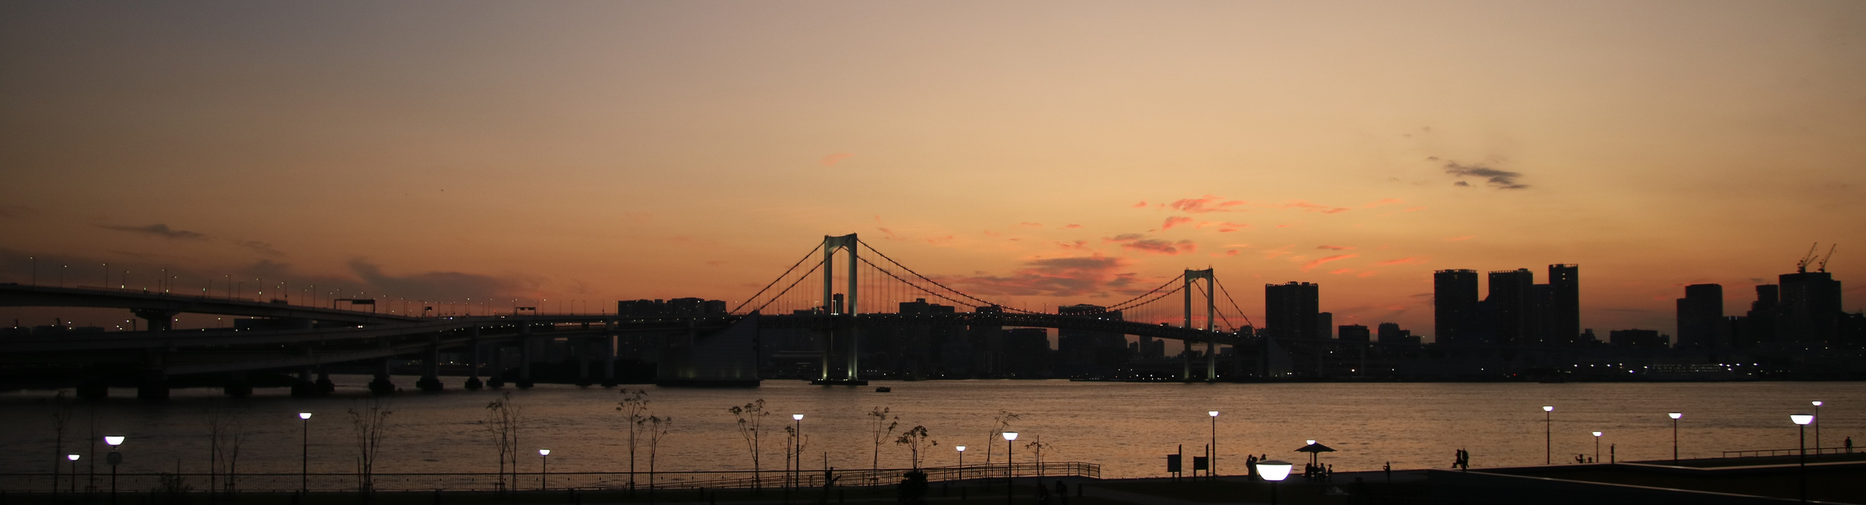
Rise Housing Solutions
Who We Are
We partner with local jurisdictions and companies in the Bay Area to advance affordable housing goals via equitable program design and management. Other jurisdictions include Novato, Daly City, Alameda, San Leandro and 777 Hamilton (Teacher Housing)
BMR WORKSHOP | 2025

Slide 5

CITY OF CUPERTINO BELOW MARKET RATE PROGRAM
BMR RENTAL PROGRAM

Slide 6
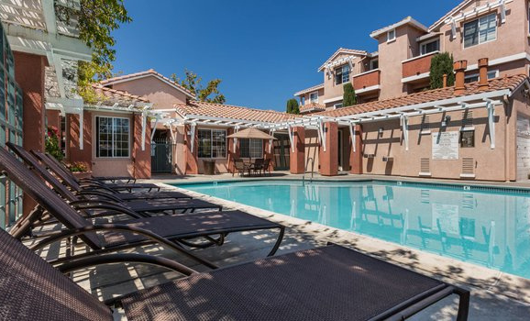
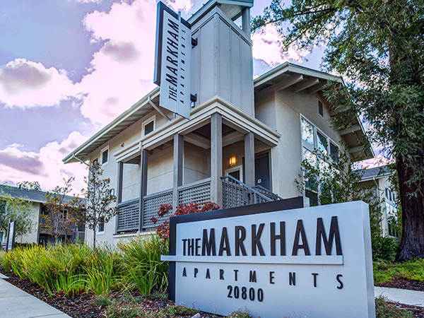
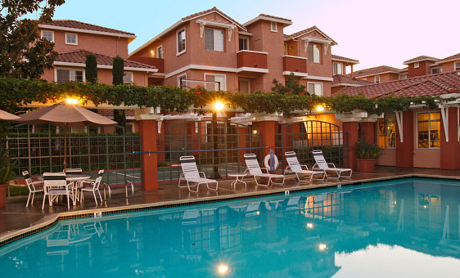
BMR Rental Inventory
142 RENTAL UNITS*
9 DIFFERENT BUILDINGS
1, 2 AND 3 BEDROOMS
Average turnover 15-25 times per year
BMR WORKSHOP | 2025

Slide 7
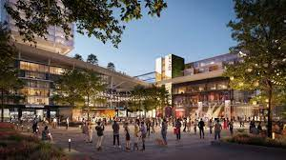
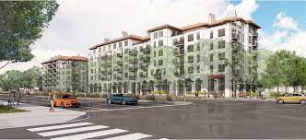
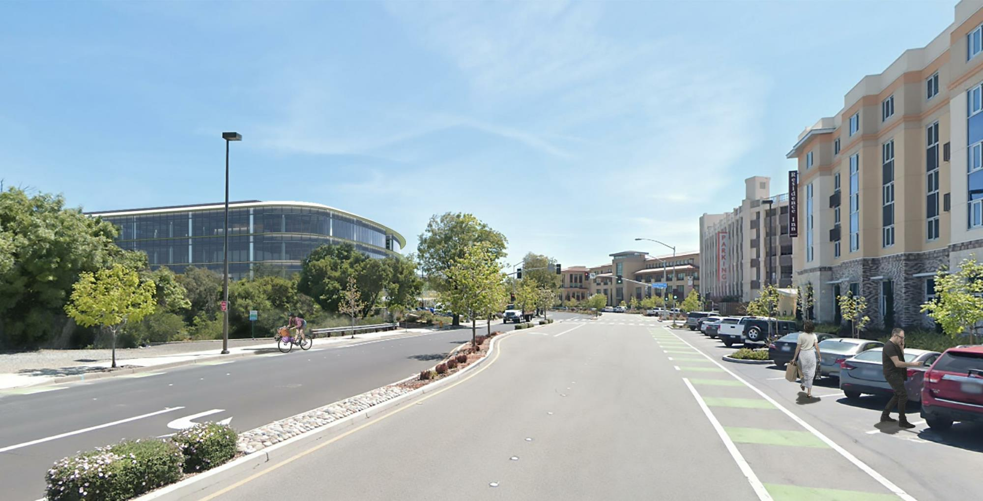
New Developments
https://www.cupertino.org/our-city/departments/community-development/planning/major-projects
There are currently no new developments in the pipeline for 2025 that will be managed by Rise Housing, that will be part of the BMR Housing program; however, we are committed to notifying everyone who has signed up on our website of any affordable housing opportunities in the City of Cupertino as they arise.
www.risehousing.com/rise-updates
You can periodically check the City’s website for updates regarding new developments.
BMR WORKSHOP | 2025

Slide 8

Income Limits
The BMR rental program is designed to assist
  Extremely Low-Income (up to 30% AMI) (only occasional units at specific properties)
  Very Low-Income (up to 50% AMI)
  Low-Income (up to 80% AMI)
*Income limits published by HCD annually for Santa Clara County,
BMR WORKSHOP | 2025
Notes:
Income limits are published annually in May at HCD.CA.GOV

Slide 9
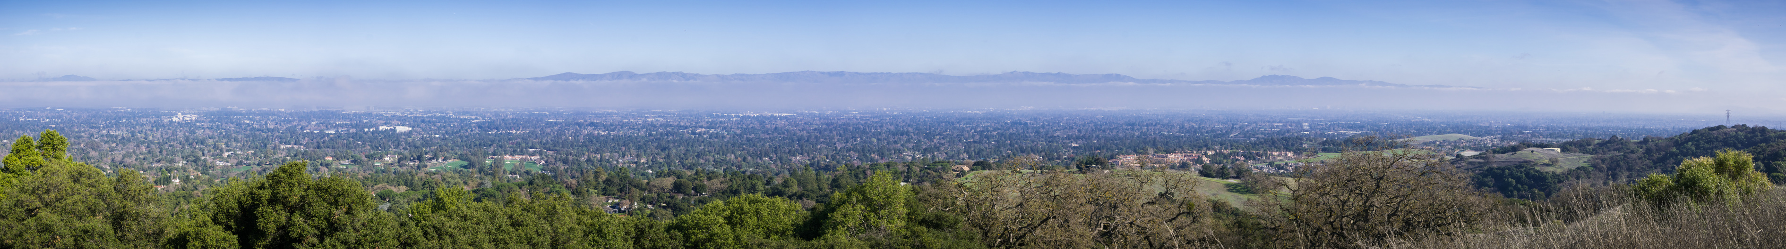
BMR WORKSHOP | 2025

Slide 10
Asset Limit
Household assets may not exceed the maximum gross income allowed for the household size.
BMR WORKSHOP | 2025

Slide 11




WHAT IS COUNTED AS AN ASSET?
  Combined assets including:
    Checking and Savings Accounts
    Stocks
    Mutual Funds
    Profit Sharing Accounts
    CD's
    Money Market Accounts
  Excluded from assets are all non-accessible funds that generate a penalty when withdrawn, i.e., 401k, CALPERS, STRS, and other pension plans
BMR WORKSHOP | 2025
Notes:
Cars or any material possession is not counted as asset

Slide 12
No members of the household may currently own a home or be on title of any property, anywhere in the world
Current BMR Tenants may not apply for the 2025 City of Cupertino BMR Waitlist.*
BMR WORKSHOP | 2025

Slide 13
*The City and Rise Housing are aware that some restrictions on BMR rental units are set to expire within the next two years, which could impact current tenants. The City is in the process of crafting potential solutions to prioritize these tenants and minimize displacement. This potential prioritization could impact the current waitlist in 2025 and/or 2026.
BMR WORKSHOP | 2025
BMR WORKSHOP | 2025

Slide 14
CITY OF CUPERTINO BELOW MARKET RATE PROGRAM
BMR PURCHASE PROGRAM

Slide 15
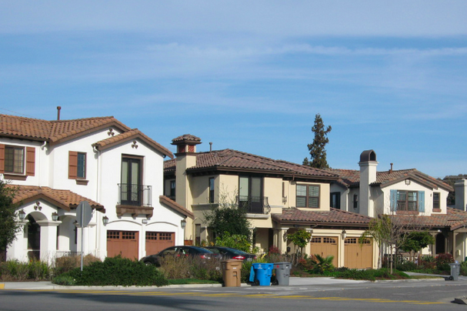
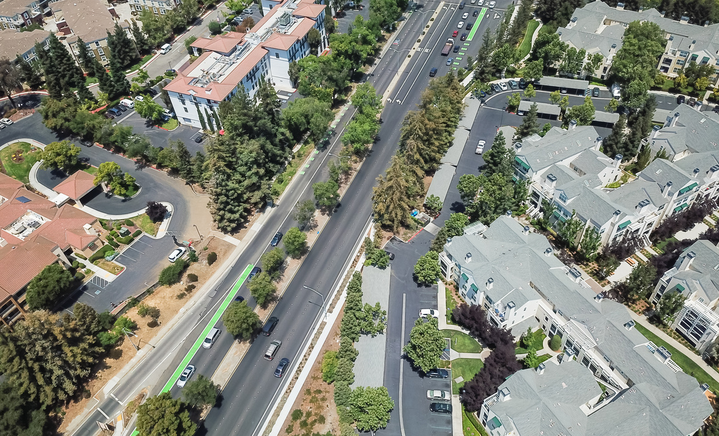
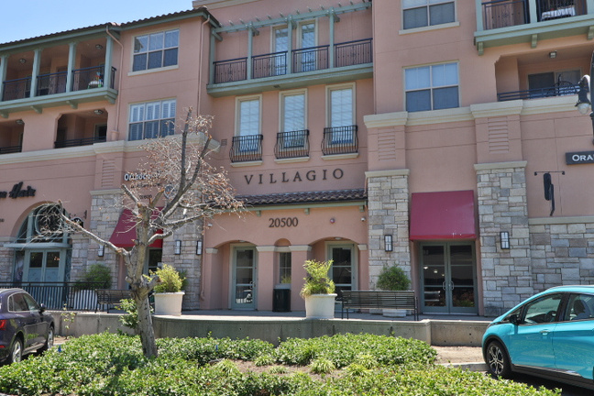
BMR Purchase Program
119 BMR HOMES
MIX OF CONDOS, TOWNHOMES, & SINGLE-FAMILY HOMES
1- 4 BEDROOM UNITS
Average turnover 1-2 times per year
BMR WORKSHOP | 2025

Slide 16
CITY OF CUPERTINO BELOW MARKET RATE PROGRAM
BMR PURCHASE PROGRAM
ELIGIBILITY REQUIREMENTS

Slide 17
Income Limits
The BMR ownership program is designed to assist first-time median- and moderate-income homebuyers.
  Median Income (up to 100% AMI)
  Moderate Income (up to 120% AMI)
*Income limits published by HCD annually for Santa Clara County,
BMR WORKSHOP | 2025

Slide 18
Asset Limit
Household with assets over $100,000 or 30% of the BMR purchase price, whichever is greater, held in the United States or foreign countries, will not be eligible to purchase a BMR home.
BMR WORKSHOP | 2025

Slide 19
WHAT IS COUNTED AS AN ASSET?
  Combined assets including:
    Checking and Savings Accounts
    Stocks
    Mutual Funds
    Profit Sharing Accounts
    CD's
    Money Market Accounts
  Excluded from assets are all non-accessible funds that generate a penalty when withdrawn, i.e., 401k, CALPERS, STRS, and other pension plans
BMR WORKSHOP | 2025

Slide 20
5% MINIMUM CASH REQUIREMENT
Available cash for Down Payment and Closing Costs
Minimum of 3% must be buyers own funds
2% can come from gift funds
Pricing will vary but a minimum of $12,500 would be needed to qualify
BMR WORKSHOP | 2025
Notes:
Cash can be coming from a checking account or liquidating stocks, but it must come from the buyer’s own funds.

Slide 21
First-time Homebuyers
All applicants who will be on property title must be first-time homebuyers.*
Applicant(s) shall be considered a first-time homebuyer if they have not owned any residential real estate for at least three years. This definition applies to property owned in foreign countries as well as in the United States.
An exception will be made for people who were homeowners prior to a divorce or widowed.
1
2
BMR WORKSHOP | 2025

Slide 22
CITY OF CUPERTINO BELOW MARKET RATE PROGRAM
PRIORITY POINTS & LOTTERY PROCESS

Slide 23
PRIORITY POINTS
APPLICANTS ARE DIVIDED INTO CATEGORIES BASED ON THEIR PRIORITY POINTS:
1 POINT
2 POINTS
1 POINT
4 POINTS
Cupertino Resident
Working in Cupertino
Public Employee Working in Cupertino*
=
Maximum (Highest Priority)
*Public employees MUST work in Cupertino. This includes school district employees, City employees, police, fire, post office, etc.
BMR WORKSHOP | 2025

Slide 24
Lottery Process
Applicants who re-apply from the previous year will take priority over new applicants who are in the same preference point bracket.
Applicants who were on the waitlist in previous years must re-apply to be eligible for the 2025 waitlist
Applicants can apply for both the Rental and Purchase 2025 waitlists.
BMR WORKSHOP | 2025
Notes:
two separate application links will be made available, applicants who wish to apply for both waitlists must apply for each waitlist separately.

Slide 25
Lottery Process
  New applicants will be added to the bottom of the list of the priority group for which they are eligible, after applicants who were on the 2025 waitlist and have re-applied.
  A Lottery will be held for all new applicants to determine a random waitlist ranking order in each priority group (0,1,2,3,4).
  All applicants will be emailed/mailed results of their application specifying if they have been approved or denied and, if approved, their applicant number of the waitlist by the end of December.
BMR WORKSHOP | 2025

Slide 26
False or Inaccurate Information
All information provided on the waitlist application will be verified by Rise Housing Solutions before any applicant can receive final approval for a BMR Unit.
Your household will be disqualified if:
1
You falsify documents or information
2
Multiple applications are submitted by the same household
Supporting documentation includes, but is not limited to, verification of identity, pay stubs, tax returns, and financial statements.
BMR WORKSHOP | 2025

Slide 27



How to join the 2025 Waitlist
Application Period:
Tuesday, October 1, 2025 - Thursday, October 31, 2025 at 5:00 PM
By Mail
By Email
Online - Recommended
Rise Housing
Cupertino 2025 Waitlist
1990 N. California Blvd Ste 8th Floor #1074
Walnut Creek, CA 94596
cupertino@risehousing.com
www.risehousing.com
BMR WORKSHOP | 2025
Notes:
There will be no in person drop offs, either to the City or to Rise Housing, all applications must be received either by mail, email or online.

Slide 28
Contact Information
Mailing address
1990 N. California Blvd Ste 8th Floor #1074
Walnut Creek, CA, 94596
Email address
cupertino@risehousing.com
Phone number
(415) 301-5448

Slide 29
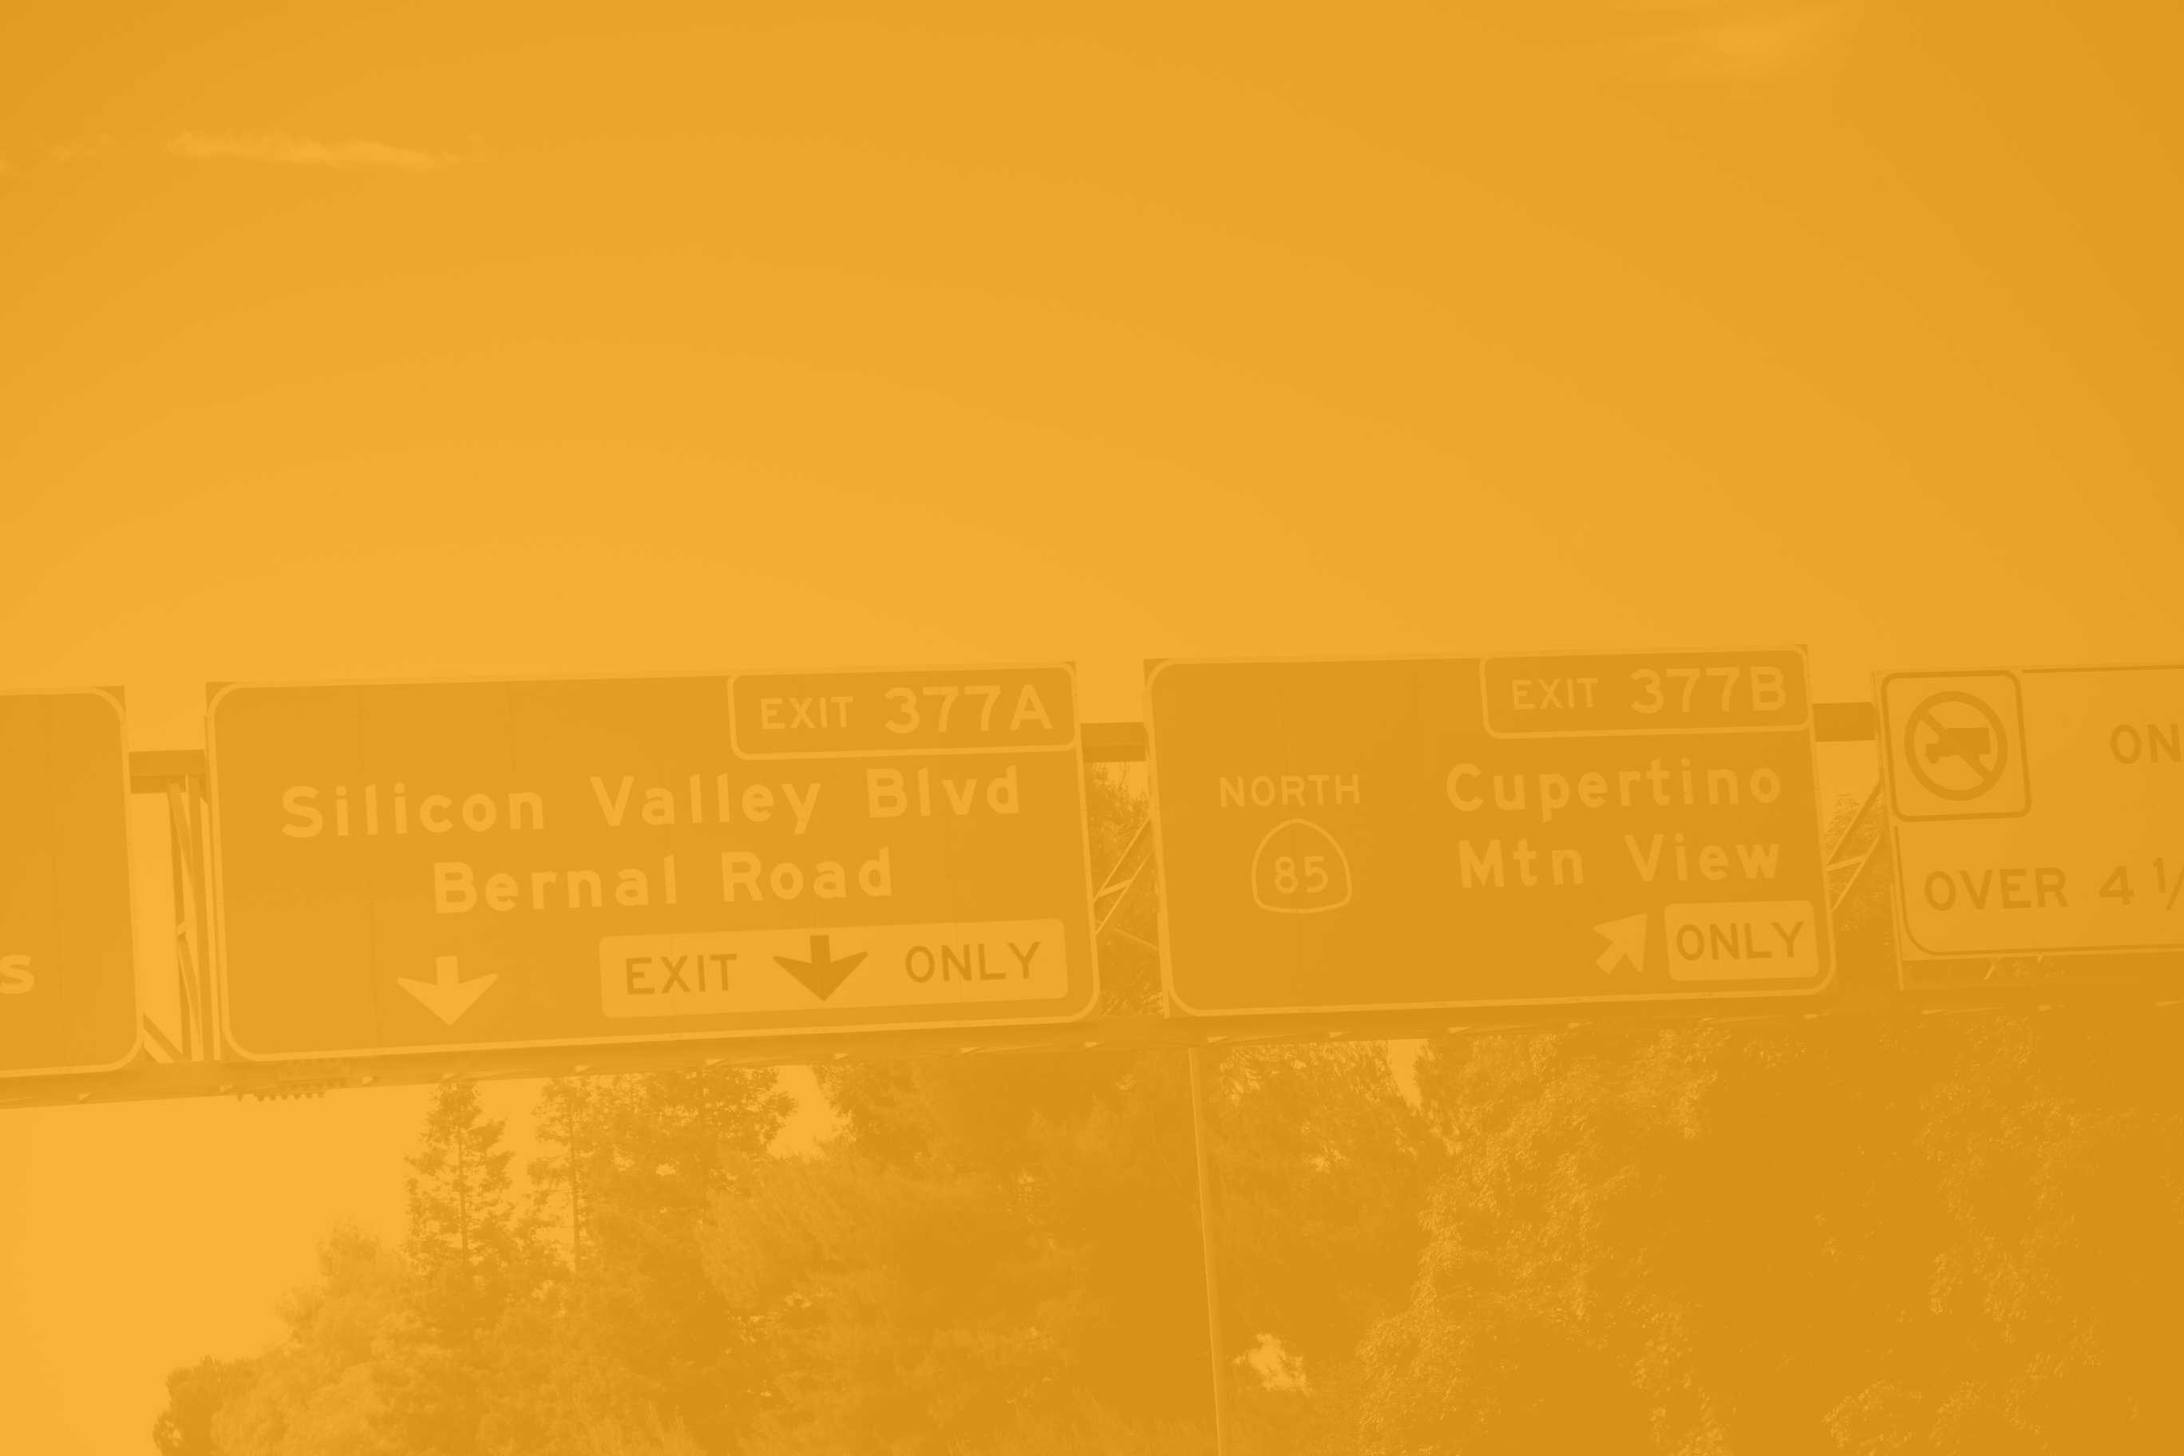
Questions

Slide 30
Thank You

